Slide 1

NAB Banking Month-End Reconciliation SQL Project
Michael Le

Slide 2
Requirements
Install and Download SQL Server Express (2022,or 2025 (much preferred)) from Microsoft
Files and sources from my repository:
Main-Stuff/DA Bootcamp 2026 Emergi Mentors/Week 2 SQL Mastery/Module 4 Advanced SQL and Enterprise Analytics/NAD_Banking_Month_End_Reconciliation at main · Mikele02171/Main-Stuff

Slide 3

Content
Create a fresh database for NAB Banking
DDL: Create table for accounts, transactions
DDL: Create indexes for performance
DML: Inserts values for accounts and transactions
DQL: Validation Check
Temp table for #HighValueAccounts
Temp table with Indexes for #December Transactions
Temp table for #QuickTemp
Temp table for @AccountSummary
Temp table for @BatchTest and #SessionTest
Month-End Reconciliation Workflow
December 2024 Month-End reconciliation Report
DDL: Create Global temp table #SharedAccountList
Stored Procedure for dbo.MonthEndReconciliation
Temp Table for #HighValueCounts
Table Variable for Small Dataset for @TransactionSummary
Temp Table for #AllTransactions and #DailyTotals
Temp Table with All Transactions, #AllTx
Stored Procedure for dbo.QuarterlyReconciliation
Scenario 1: Small Dataset, single use -> Table Variable
Scenario 2: Large Dataset, multiple steps -> Temp Table
Scenario 3: Single query readability -> CTE

Slide 4
Create a fresh database for NAB Banking
-- Clean slate for training session
USE master;
GO
-- Drop database if exists (training reset)
IF DB_ID('NAB_Banking') IS NOT NULL
BEGIN
ALTER DATABASE NAB_Banking SET SINGLE_USER WITH ROLLBACK IMMEDIATE;
DROP DATABASE NAB_Banking;
END
GO
-- Create fresh database
CREATE DATABASE NAB_Banking;
GO
USE NAB_Banking;
GO
PRINT '✓ Database NAB_Banking created successfully';
PRINT '';
GO

Slide 5
DDL: Create table for accounts, transactions
-- Accounts table
CREATE TABLE accounts (
account_id INT PRIMARY KEY IDENTITY(1,1),
account_number NVARCHAR(20) NOT NULL UNIQUE,
customer_name NVARCHAR(100) NOT NULL,
account_type NVARCHAR(50) NOT NULL,
opening_balance DECIMAL(15,2) NOT NULL DEFAULT 0,
created_date DATETIME NOT NULL DEFAULT GETDATE(),
status NVARCHAR(20) NOT NULL DEFAULT 'Active',
CONSTRAINT CK_account_type CHECK (account_type IN ('Savings', 'Checking', 'Business', 'Investment'))
);
-- Transactions table
CREATE TABLE transactions (
transaction_id INT PRIMARY KEY IDENTITY(1,1),
account_id INT NOT NULL,
transaction_date DATETIME NOT NULL DEFAULT GETDATE(),
amount DECIMAL(15,2) NOT NULL,
transaction_type NVARCHAR(50) NOT NULL,
description NVARCHAR(200),
CONSTRAINT FK_transactions_accounts FOREIGN KEY (account_id) REFERENCES accounts(account_id),
CONSTRAINT CK_transaction_type CHECK (transaction_type IN ('Deposit', 'Withdrawal', 'Transfer', 'Fee', 'Interest'))
);

Slide 6
DDL: Create indexes for performance
-- Create indexes for performance
CREATE INDEX IX_transactions_account_date ON transactions(account_id, transaction_date);
CREATE INDEX IX_transactions_date ON transactions(transaction_date);
CREATE INDEX IX_accounts_status ON accounts(status);

Slide 7
DML: Inserts values for accounts and transactions
INSERT INTO accounts (account_number, customer_name, account_type, opening_balance, created_date)
VALUES
('NAD-001-SAV', 'James Anderson', 'Savings', 75000.00, '2024-01-15'),
('NAD-002-CHK', 'Sarah Mitchell', 'Checking', 45000.00, '2024-01-20'),
('NAD-003-BUS', 'TechStart Solutions Pty Ltd', 'Business', 125000.00, '2024-02-01'),
('NAD-004-SAV', 'Emma Thompson', 'Savings', 32000.00, '2024-02-10'),
('NAD-005-INV', 'Robert Chen', 'Investment', 250000.00, '2024-02-15'),
('NAD-006-CHK', 'Maria Garcia', 'Checking', 28000.00, '2024-03-01'),
('NAD-007-BUS', 'Melbourne Retail Group', 'Business', 180000.00, '2024-03-05'),
('NAD-008-SAV', 'David Wilson', 'Savings', 55000.00, '2024-03-10'),
('NAD-009-CHK', 'Lisa Brown', 'Checking', 12000.00, '2024-03-15'),
('NAD-010-SAV', 'Michael O''Connor', 'Savings', 48000.00, '2024-03-20'),
('NAD-011-BUS', 'Sydney Import Export', 'Business', 95000.00, '2024-04-01'),
('NAD-012-INV', 'Jennifer Lee', 'Investment', 175000.00, '2024-04-05'),
('NAD-013-CHK', 'Thomas White', 'Checking', 38000.00, '2024-04-10'),
('NAD-014-SAV', 'Patricia Moore', 'Savings', 62000.00, '2024-04-15'),
('NAD-015-BUS', 'Brisbane Consulting', 'Business', 88000.00, '2024-04-20'),
('NAD-016-CHK', 'Christopher Taylor', 'Checking', 25000.00, '2024-05-01'),
('NAD-017-SAV', 'Amanda Jackson', 'Savings', 71000.00, '2024-05-05'),
('NAD-018-INV', 'Daniel Martin', 'Investment', 310000.00, '2024-05-10'),

Slide 8
('NAD-019-CHK', 'Michelle Thompson', 'Checking', 19000.00, '2024-05-15'),
('NAD-020-BUS', 'Perth Mining Services', 'Business', 420000.00, '2024-05-20'),
('NAD-021-SAV', 'Kevin Harris', 'Savings', 44000.00, '2024-06-01'),
('NAD-022-CHK', 'Nicole Robinson', 'Checking', 31000.00, '2024-06-05'),
('NAD-023-BUS', 'Adelaide Wine Distributors', 'Business', 135000.00, '2024-06-10'),
('NAD-024-SAV', 'Steven Clark', 'Savings', 58000.00, '2024-06-15'),
('NAD-025-INV', 'Rebecca Lewis', 'Investment', 225000.00, '2024-06-20'),
('NAD-026-CHK', 'Brian Walker', 'Checking', 22000.00, '2024-07-01'),
('NAD-027-SAV', 'Jessica Hall', 'Savings', 67000.00, '2024-07-05'),
('NAD-028-BUS', 'Canberra Tech Hub', 'Business', 98000.00, '2024-07-10'),
('NAD-029-CHK', 'Ryan Young', 'Checking', 15000.00, '2024-07-15'),
('NAD-030-SAV', 'Lauren King', 'Savings', 52000.00, '2024-07-20'),
('NAD-031-BUS', 'Hobart Seafood Exports', 'Business', 165000.00, '2024-08-01'),
('NAD-032-INV', 'Jason Wright', 'Investment', 280000.00, '2024-08-05'),
('NAD-033-CHK', 'Stephanie Green', 'Checking', 27000.00, '2024-08-10'),
('NAD-034-SAV', 'Brandon Baker', 'Savings', 73000.00, '2024-08-15'),
('NAD-035-BUS', 'Darwin Logistics', 'Business', 112000.00, '2024-08-20'),
('NAD-036-CHK', 'Melissa Adams', 'Checking', 18000.00, '2024-09-01'),
('NAD-037-SAV', 'Eric Nelson', 'Savings', 64000.00, '2024-09-05'),
('NAD-038-INV', 'Samantha Carter', 'Investment', 195000.00, '2024-09-10'),
('NAD-039-CHK', 'Gregory Mitchell', 'Checking', 33000.00, '2024-09-15'),

Slide 9
('NAD-040-BUS', 'Newcastle Steel Works', 'Business', 285000.00, '2024-09-20'),
('NAD-041-SAV', 'Heather Perez', 'Savings', 49000.00, '2024-10-01'),
('NAD-042-CHK', 'Jonathan Roberts', 'Checking', 24000.00, '2024-10-05'),
('NAD-043-BUS', 'Gold Coast Tourism', 'Business', 155000.00, '2024-10-10'),
('NAD-044-SAV', 'Rachel Turner', 'Savings', 81000.00, '2024-10-15'),
('NAD-045-INV', 'Adam Phillips', 'Investment', 340000.00, '2024-10-20'),
('NAD-046-CHK', 'Kimberly Campbell', 'Checking', 29000.00, '2024-11-01'),
('NAD-047-SAV', 'Justin Parker', 'Savings', 56000.00, '2024-11-05'),
('NAD-048-BUS', 'Wollongong Manufacturing', 'Business', 198000.00, '2024-11-10'),
('NAD-049-CHK', 'Brittany Evans', 'Checking', 21000.00, '2024-11-15'),
('NAD-050-SAV', 'Tyler Edwards', 'Savings', 69000.00, '2024-11-20');
PRINT '✓ Inserted 50 customer accounts';
PRINT '';
GO

Slide 10
-- Insert realistic December 2024 transactions (15,000+ transactions)
-- This simulates a month of banking activity
DECLARE @AccountID INT = 1;
DECLARE @TransactionDate DATETIME;
DECLARE @DayCounter INT;
DECLARE @TxPerDay INT;
DECLARE @Amount DECIMAL(15,2);
DECLARE @TxType NVARCHAR(50);

Slide 11
-- Loop through each account
WHILE @AccountID <= 50
BEGIN
SET @DayCounter = 1;
-- Generate transactions for each day in December 2024
WHILE @DayCounter <= 31
BEGIN
SET @TransactionDate = DATEADD(DAY, @DayCounter - 1, '2024-12-01');
SET @TxPerDay = FLOOR(RAND() * 15) + 5; -- 5-20 transactions per day per account

Slide 12
DECLARE @TxCounter INT = 1;
WHILE @TxCounter <= @TxPerDay
BEGIN
-- Randomize transaction types and amounts
DECLARE @RandType FLOAT = RAND();
IF @RandType < 0.4 -- 40% Deposits
BEGIN
SET @TxType = 'Deposit';
SET @Amount = ROUND(RAND() * 5000 + 100, 2); -- $100-$5,100
END
ELSE IF @RandType < 0.7 -- 30% Withdrawals
BEGIN
SET @TxType = 'Withdrawal';
SET @Amount = -ROUND(RAND() * 3000 + 50, 2); -- -$50 to -$3,050
END
ELSE IF @RandType < 0.85 -- 15% Transfers
BEGIN
SET @TxType = 'Transfer';
SET @Amount = CASE
WHEN RAND() > 0.5 THEN ROUND(RAND() * 2000 + 100, 2)
ELSE -ROUND(RAND() * 2000 + 100, 2)
END;
END
ELSE IF @RandType < 0.95 -- 10% Fees

Slide 13
BEGIN
SET @TxType = 'Fee';
SET @Amount = -ROUND(RAND() * 50 + 5, 2); -- -$5 to -$55
END
ELSE -- 5% Interest
BEGIN
SET @TxType = 'Interest';
SET @Amount = ROUND(RAND() * 200 + 10, 2); -- $10-$210
END
-- Add some time variance to transaction
SET @TransactionDate = DATEADD(MINUTE, FLOOR(RAND() * 1440), @TransactionDate);
INSERT INTO transactions (account_id, transaction_date, amount, transaction_type, description)
VALUES (
@AccountID,
@TransactionDate,
@Amount,
@TxType,
@TxType + ' - ' + FORMAT(@TransactionDate, 'dd/MM/yyyy HH:mm')
);
SET @TxCounter = @TxCounter + 1;
END
SET @DayCounter = @DayCounter + 1;
END
SET @AccountID = @AccountID + 1;
END
GO

Slide 14

DQL: Validation Check
-- Display data summary
SELECT
'Total Accounts' AS Metric,
COUNT(*) AS Value
FROM accounts
UNION ALL
SELECT
'Total Transactions',
COUNT(*)
FROM transactions
UNION ALL
SELECT
'December 2024 Transactions',
COUNT(*)
FROM transactions
WHERE transaction_date >= '2024-12-01' AND transaction_date < '2025-01-01';

Slide 15
Temp table for #HighValueAccounts
-- Create temp table for high-value accounts
CREATE TABLE #HighValueAccounts (
account_id INT,
account_number NVARCHAR(20),
customer_name NVARCHAR(100),
account_type NVARCHAR(50),
opening_balance DECIMAL(15,2)
);
-- Populate temp table
INSERT INTO #HighValueAccounts
SELECT
account_id,
account_number,
customer_name,
account_type,
opening_balance
FROM accounts
WHERE opening_balance > 50000;

Slide 16
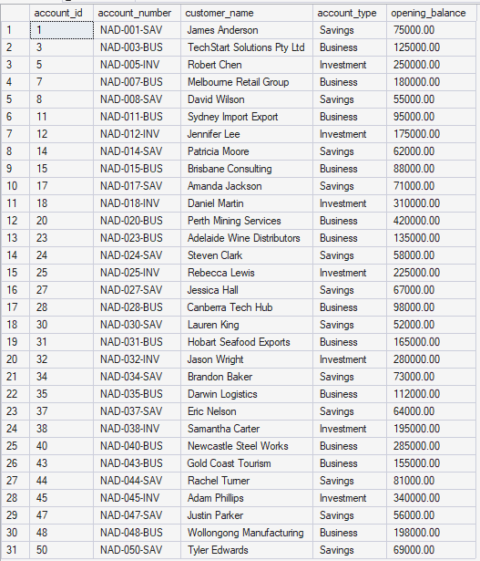
-- Query temp table
SELECT
'High Value Accounts (>$50,000)' AS Category,
COUNT(*) AS AccountCount,
AVG(opening_balance) AS AvgBalance,
MAX(opening_balance) AS MaxBalance
FROM #HighValueAccounts;
PRINT '';
SELECT * FROM #HighValueAccounts ORDER BY opening_balance DESC;
-- Verify temp table exists in tempdb
PRINT '';
PRINT 'Temp table physical location:';
SELECT
name AS TempTableName,
create_date AS CreatedAt
FROM tempdb.sys.tables
WHERE name LIKE '#HighValueAccounts%';
-- Clean up
DROP TABLE #HighValueAccounts;
PRINT '';
PRINT '✓ Temp table dropped successfully';
PRINT '';
GO

Slide 17
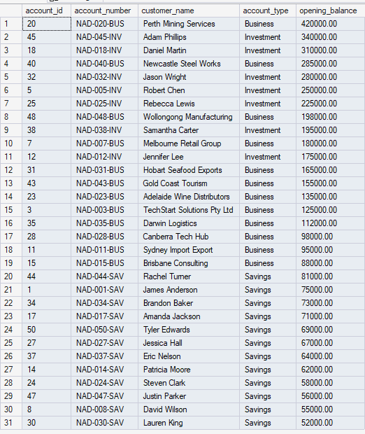
Opening Balance in Descending Order
Temporary Table Name

Slide 18
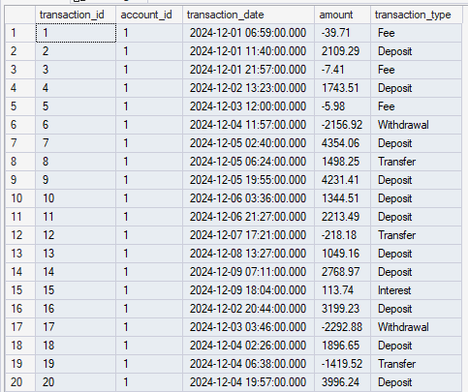

Temp table with Indexes for #DecemberTransactions
-- Create temp table for all December transactions
CREATE TABLE #DecemberTransactions (
transaction_id INT,
account_id INT,
transaction_date DATETIME,
amount DECIMAL(15,2),
transaction_type NVARCHAR(50)
);
-- Populate
INSERT INTO #DecemberTransactions
SELECT
transaction_id,
account_id,
transaction_date,
amount,
transaction_type
FROM transactions
WHERE transaction_date >= '2024-12-01'
AND transaction_date < '2025-01-01';
PRINT 'Records in #DecemberTransactions:';
SELECT COUNT(*) AS RecordCount FROM #DecemberTransactions;
First 20 rows, for #DecemberTransactions
Total Records Count

Slide 19
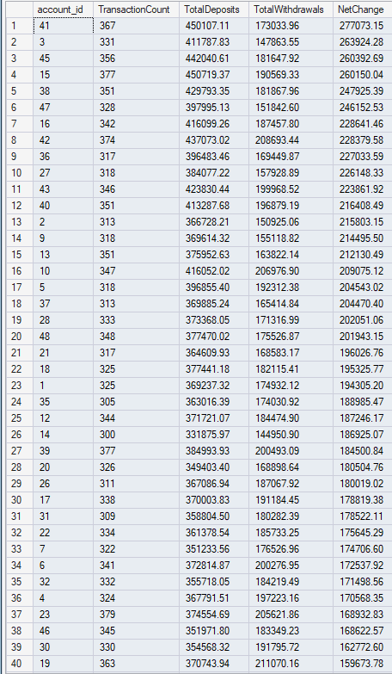
-- Add index for performance
CREATE INDEX IX_AccountID ON #DecemberTransactions(account_id);
CREATE INDEX IX_TransactionDate ON #DecemberTransactions(transaction_date);
-- Now query with improved performance
SELECT
account_id,
COUNT(*) AS TransactionCount,
SUM(CASE WHEN amount > 0 THEN amount ELSE 0 END) AS TotalDeposits,
SUM(CASE WHEN amount < 0 THEN ABS(amount) ELSE 0 END) AS TotalWithdrawals,
SUM(amount) AS NetChange
FROM #DecemberTransactions
GROUP BY account_id
ORDER BY NetChange DESC;
First 40 rows for December 2024 Transactions

Slide 20
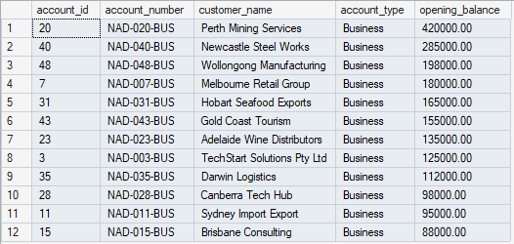
Temp table for #QuickTemp
-- Create temp table automatically with SELECT INTO
SELECT
account_id,
account_number,
customer_name,
account_type,
opening_balance
INTO #QuickTemp
FROM accounts
WHERE account_type = 'Business';
PRINT 'Business accounts in #QuickTemp:';
SELECT * FROM #QuickTemp ORDER BY opening_balance DESC;

Slide 21
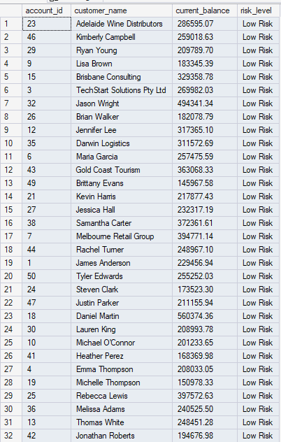
Temp table for @AccountSummary
PRINT '--- DEMO 4: Table Variable Basics ---';
PRINT '';
-- Declare table variable
DECLARE @AccountSummary TABLE (
account_id INT,
customer_name NVARCHAR(100),
current_balance DECIMAL(15,2),
risk_level NVARCHAR(20)
);
-- Populate table variable
INSERT INTO @AccountSummary
SELECT
a.account_id,
a.customer_name,
a.opening_balance + ISNULL(SUM(t.amount), 0) AS current_balance,
CASE
WHEN a.opening_balance + ISNULL(SUM(t.amount), 0) < 1000 THEN 'High Risk'
WHEN a.opening_balance + ISNULL(SUM(t.amount), 0) < 5000 THEN 'Medium Risk'
ELSE 'Low Risk'
END AS risk_level
FROM accounts a
LEFT JOIN transactions t ON a.account_id = t.account_id
WHERE t.transaction_date >= '2024-12-01'
AND t.transaction_date < '2025-01-01'
GROUP BY a.account_id, a.customer_name, a.opening_balance;
First 32 rows are @Account Summary

Slide 22

-- Query table variable
PRINT 'Account Risk Analysis:';
SELECT
risk_level,
COUNT(*) AS AccountCount,
AVG(current_balance) AS AvgBalance
FROM @AccountSummary
GROUP BY risk_level
ORDER BY
CASE risk_level
WHEN 'High Risk' THEN 1
WHEN 'Medium Risk' THEN 2
ELSE 3
END;

Slide 23
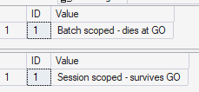
Temp table for @BatchTest and #SessionTest
-- Table variable - dies at GO
DECLARE @BatchTest TABLE (ID INT, Value NVARCHAR(50));
INSERT INTO @BatchTest VALUES (1, 'Batch scoped - dies at GO');
SELECT * FROM @BatchTest;
PRINT 'Table variable exists in this batch';
GO
-- This will fail - table variable out of scope
-- SELECT * FROM @BatchTest; -- Uncomment to see error
-- Temp table - survives GO
CREATE TABLE #SessionTest (ID INT, Value NVARCHAR(50));
INSERT INTO #SessionTest VALUES (1, 'Session scoped - survives GO');
GO
SELECT * FROM #SessionTest;
PRINT 'Temp table survives across batches!';

Slide 24
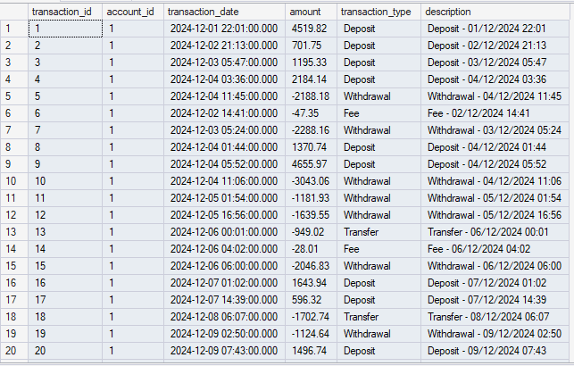
Month-End Reconciliation Workflow
-- STEP 1: Extract December Transactions
PRINT 'STEP 1: Extracting December 2024 transactions...';
CREATE TABLE #Step1_Transactions (
transaction_id INT,
account_id INT,
transaction_date DATETIME,
amount DECIMAL(15,2),
transaction_type NVARCHAR(50),
description NVARCHAR(200)
);
INSERT INTO #Step1_Transactions
SELECT
transaction_id,
account_id,
transaction_date,
amount,
transaction_type,
description
FROM transactions
WHERE transaction_date >= '2024-12-01'
AND transaction_date < '2025-01-01';
-- Add index for performance
CREATE INDEX IX_Account ON #Step1_Transactions(account_id);
CREATE INDEX IX_Date ON #Step1_Transactions(transaction_date);
DECLARE @Step1Count INT = (SELECT COUNT(*) FROM #Step1_Transactions);
PRINT ' ✓ Extracted ' + CAST(@Step1Count AS NVARCHAR(10)) + ' transactions';
PRINT '';
First 20 rows for #Step1_Transactions

Slide 25
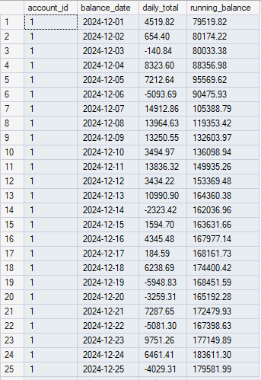
PRINT 'STEP 2: Calculating daily running balances per account...';
CREATE TABLE #Step2_DailyBalances (
account_id INT,
balance_date DATE,
daily_total DECIMAL(15,2),
running_balance DECIMAL(15,2)
);
INSERT INTO #Step2_DailyBalances
SELECT
t.account_id,
CAST(t.transaction_date AS DATE) AS balance_date,
SUM(t.amount) AS daily_total,
a.opening_balance + SUM(SUM(t.amount)) OVER (
PARTITION BY t.account_id
ORDER BY CAST(t.transaction_date AS DATE)
ROWS BETWEEN UNBOUNDED PRECEDING AND CURRENT ROW
) AS running_balance
FROM #Step1_Transactions t
JOIN accounts a ON t.account_id = a.account_id
GROUP BY t.account_id, CAST(t.transaction_date AS DATE), a.opening_balance;
CREATE INDEX IX_AccountDate ON #Step2_DailyBalances(account_id, balance_date);
DECLARE @Step2Count INT = (SELECT COUNT(*) FROM #Step2_DailyBalances);
PRINT ' ✓ Calculated ' + CAST(@Step2Count AS NVARCHAR(10)) + ' daily balance records';
PRINT '';
First 25 rows for #Step2_DailyBalances

Slide 26
-- STEP 3: Identify Overdraft Instances
PRINT 'STEP 3: Identifying overdraft instances...';
CREATE TABLE #Step3_Overdrafts (
account_id INT,
overdraft_date DATE,
overdraft_amount DECIMAL(15,2),
severity NVARCHAR(20)
);
INSERT INTO #Step3_Overdrafts
SELECT
account_id,
balance_date AS overdraft_date,
running_balance AS overdraft_amount,
CASE
WHEN running_balance < -10000 THEN 'Critical'
WHEN running_balance < -5000 THEN 'High'
WHEN running_balance < 0 THEN 'Medium'
END AS severity
FROM #Step2_DailyBalances
WHERE running_balance < 0;
DECLARE @Step3Count INT = (SELECT COUNT(*) FROM #Step3_Overdrafts);
PRINT ' ✓ Identified ' + CAST(@Step3Count AS NVARCHAR(10)) + ' overdraft instances';
PRINT '';
Expect the running balance is not below 0.

Slide 27
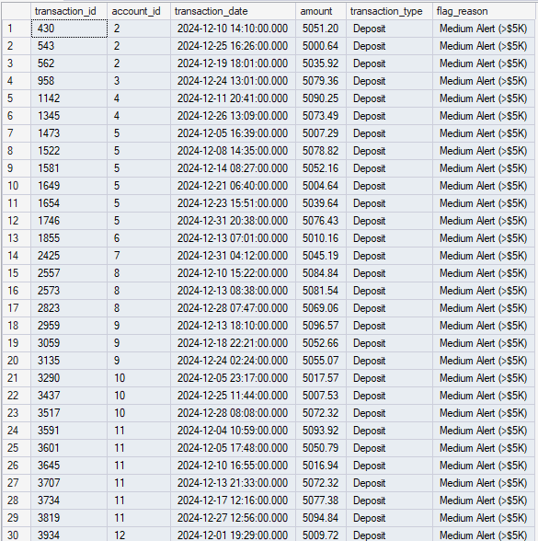
PRINT 'STEP 4: Flagging suspicious large transactions...';
CREATE TABLE #Step4_SuspiciousTransactions (
transaction_id INT,
account_id INT,
transaction_date DATETIME,
amount DECIMAL(15,2),
transaction_type NVARCHAR(50),
flag_reason NVARCHAR(100)
);
INSERT INTO #Step4_SuspiciousTransactions
SELECT
transaction_id,
account_id,
transaction_date,
amount,
transaction_type,
CASE
WHEN ABS(amount) > 50000 THEN 'Critical Alert (>$50K)'
WHEN ABS(amount) > 10000 THEN 'Large Transaction (>$10K)'
WHEN ABS(amount) > 5000 THEN 'Medium Alert (>$5K)'
END AS flag_reason
FROM #Step1_Transactions
WHERE ABS(amount) > 5000;
DECLARE @Step4Count INT = (SELECT COUNT(*) FROM #Step4_SuspiciousTransactions);
PRINT ' ✓ Flagged ' + CAST(@Step4Count AS NVARCHAR(10)) + ' suspicious transactions';
PRINT '';
First 30 rows for Flagging suspicious large transactions

Slide 28

PRINT 'STEP 5: Calculating fee revenue by account type...';
CREATE TABLE #Step5_FeeRevenue (
account_type NVARCHAR(50),
total_fees DECIMAL(15,2),
fee_count INT,
avg_fee DECIMAL(15,2)
);
INSERT INTO #Step5_FeeRevenue
SELECT
a.account_type,
SUM(ABS(t.amount)) AS total_fees,
COUNT(*) AS fee_count,
AVG(ABS(t.amount)) AS avg_fee
FROM #Step1_Transactions t
JOIN accounts a ON t.account_id = a.account_id
WHERE t.transaction_type = 'Fee'
GROUP BY a.account_type;
PRINT ' ✓ Fee revenue calculated by account type';
PRINT '';

Slide 29
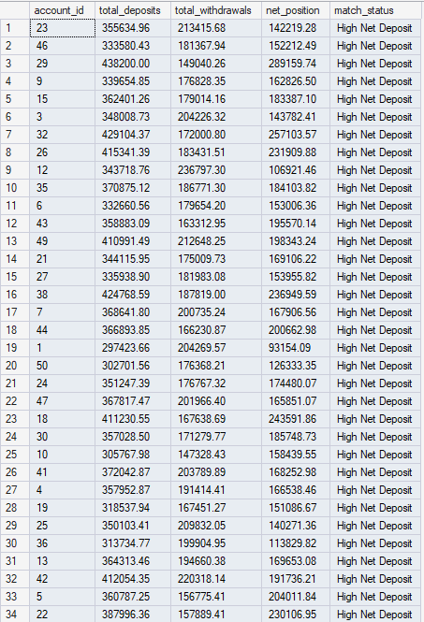
PRINT 'STEP 6: Matching deposits to withdrawals...';
CREATE TABLE #Step6_DepositWithdrawalMatch (
account_id INT,
total_deposits DECIMAL(15,2),
total_withdrawals DECIMAL(15,2),
net_position DECIMAL(15,2),
match_status NVARCHAR(50)
);
INSERT INTO #Step6_DepositWithdrawalMatch
SELECT
account_id,
SUM(CASE WHEN amount > 0 THEN amount ELSE 0 END) AS total_deposits,
SUM(CASE WHEN amount < 0 THEN ABS(amount) ELSE 0 END) AS total_withdrawals,
SUM(amount) AS net_position,
CASE
WHEN SUM(amount) > 10000 THEN 'High Net Deposit'
WHEN SUM(amount) > 0 THEN 'Net Deposit'
WHEN SUM(amount) = 0 THEN 'Balanced'
WHEN SUM(amount) > -10000 THEN 'Net Withdrawal'
ELSE 'High Net Withdrawal'
END AS match_status
FROM #Step1_Transactions
GROUP BY account_id;
First 34 rows for Matching deposits to withdrawals….

Slide 30
PRINT 'STEP 7: Identifying unmatched large transactions...';
CREATE TABLE #Step7_UnmatchedLarge (
transaction_id INT,
account_id INT,
amount DECIMAL(15,2),
transaction_type NVARCHAR(50),
issue NVARCHAR(100)
);
INSERT INTO #Step7_UnmatchedLarge
SELECT
t.transaction_id,
t.account_id,
t.amount,
t.transaction_type,
'Large unmatched ' + t.transaction_type AS issue
FROM #Step1_Transactions t
LEFT JOIN #Step6_DepositWithdrawalMatch m
ON t.account_id = m.account_id
AND ABS(t.amount) < ABS(m.net_position) * 0.1 -- Less than 10% of net position
WHERE ABS(t.amount) > 10000
AND t.transaction_type IN ('Deposit', 'Withdrawal');
DECLARE @Step7Count INT = (SELECT COUNT(*) FROM #Step7_UnmatchedLarge);
PRINT ' ✓ Identified ' + CAST(@Step7Count AS NVARCHAR(10)) + ' unmatched large transactions';
PRINT '';
Expect there is no output in unmatched large
Transactions by running this query.

Slide 31
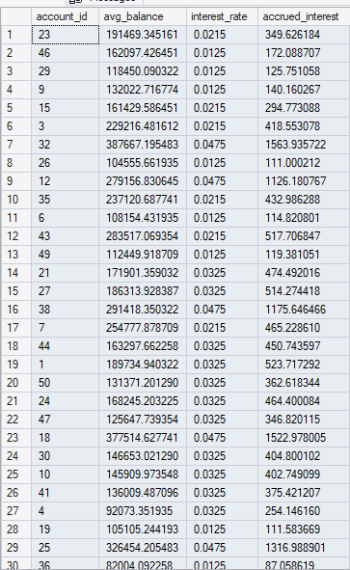
-- STEP 8: Calculate Interest Accruals
PRINT 'STEP 8: Calculating interest accruals...';
CREATE TABLE #Step8_InterestAccruals (
account_id INT,
avg_balance DECIMAL(15,2),
interest_rate DECIMAL(5,4),
accrued_interest DECIMAL(15,2)
);
INSERT INTO #Step8_InterestAccruals
SELECT
db.account_id,
AVG(db.running_balance) AS avg_balance,
CASE a.account_type
WHEN 'Savings' THEN 0.0325 -- 3.25% for Savings
WHEN 'Investment' THEN 0.0475 -- 4.75% for Investment
WHEN 'Business' THEN 0.0215 -- 2.15% for Business
ELSE 0.0125 -- 1.25% for Checking
END AS interest_rate,
AVG(db.running_balance) *
CASE a.account_type
WHEN 'Savings' THEN 0.0325
WHEN 'Investment' THEN 0.0475
WHEN 'Business' THEN 0.0215
ELSE 0.0125
END * (31.0/365.0) AS accrued_interest -- December has 31 days
FROM #Step2_DailyBalances db
JOIN accounts a ON db.account_id = a.account_id
WHERE db.running_balance > 0
GROUP BY db.account_id, a.account_type;
DECLARE @Step8Count INT = (SELECT COUNT(*) FROM #Step8_InterestAccruals);
PRINT ' ✓ Calculated interest for ' + CAST(@Step8Count AS NVARCHAR(10)) + ' accounts';
PRINT '';
First 30 rows displaying Interest Accruals

Slide 32
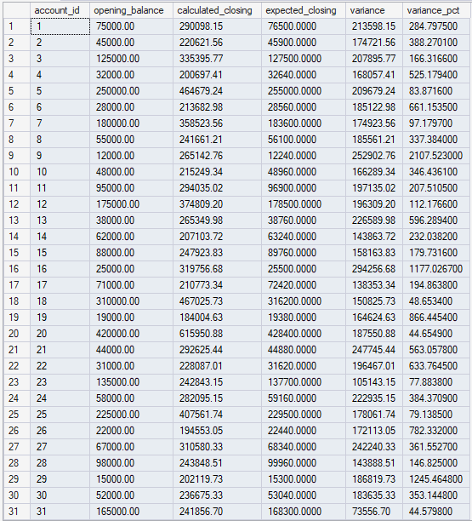
-- STEP 9: Generate Variance Report
PRINT 'STEP 9: Generating variance report...';
CREATE TABLE #Step9_VarianceReport (
account_id INT,
opening_balance DECIMAL(15,2),
calculated_closing DECIMAL(15,2),
expected_closing DECIMAL(15,2),
variance DECIMAL(15,2),
variance_pct DECIMAL(10,4)
);
INSERT INTO #Step9_VarianceReport
SELECT
a.account_id,
a.opening_balance,
a.opening_balance + ISNULL(SUM(t.amount), 0) AS calculated_closing,
a.opening_balance * 1.02 AS expected_closing, -- Expect 2% growth
(a.opening_balance + ISNULL(SUM(t.amount), 0)) - (a.opening_balance * 1.02) AS variance,
CASE
WHEN a.opening_balance > 0
THEN (((a.opening_balance + ISNULL(SUM(t.amount), 0)) - (a.opening_balance * 1.02)) / a.opening_balance) * 100
ELSE 0
END AS variance_pct
FROM accounts a
LEFT JOIN #Step1_Transactions t ON a.account_id = t.account_id
GROUP BY a.account_id, a.opening_balance;
PRINT ' ✓ Variance report generated';
PRINT '';

Slide 33
December 2024 Month-End reconciliation Report
-- Executive Summary
SELECT
'EXECUTIVE SUMMARY' AS Section,
'' AS Metric,
NULL AS Value,
NULL AS Details
UNION ALL
SELECT
'',
'Total Accounts Processed',
CAST(COUNT(DISTINCT a.account_id) AS NVARCHAR(20)),
NULL
FROM accounts a
UNION ALL

Slide 34
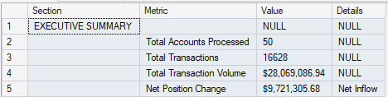
SELECT
'',
'Total Transactions',
CAST(COUNT(*) AS NVARCHAR(20)),
NULL
FROM #Step1_Transactions
UNION ALL
SELECT
'',
'Total Transaction Volume',
'$' + FORMAT(SUM(ABS(amount)), 'N2'),
NULL
FROM #Step1_Transactions
UNION ALL
SELECT
'',
'Net Position Change',
'$' + FORMAT(SUM(amount), 'N2'),
CASE WHEN SUM(amount) > 0 THEN 'Net Inflow' ELSE 'Net Outflow' END
FROM #Step1_Transactions;

Slide 35

PRINT '';
PRINT 'ACCOUNT PERFORMANCE BY TYPE:';
SELECT
a.account_type AS AccountType,
COUNT(DISTINCT a.account_id) AS TotalAccounts,
FORMAT(AVG(a.opening_balance), 'C2') AS AvgOpeningBalance,
--FORMAT(AVG(a.opening_balance + ISNULL(SUM(t.amount), 0)), 'C2') AS AvgClosingBalance, CANNOT PERFORM CALCULATION ON TEMP TABLES
FORMAT(AVG(a.opening_balance + ISNULL(t.amount, 0)), 'C2') AS AvgClosingBalance,
FORMAT(SUM(CASE WHEN t.amount > 0 THEN t.amount ELSE 0 END), 'C2') AS TotalDeposits,
FORMAT(SUM(CASE WHEN t.amount < 0 THEN ABS(t.amount) ELSE 0 END), 'C2') AS TotalWithdrawals
FROM accounts a
LEFT JOIN #Step1_Transactions t ON a.account_id = t.account_id
GROUP BY a.account_type
ORDER BY a.account_type;
PRINT '';
PRINT 'RISK ALERTS:';

Slide 36

SELECT
'Overdraft Instances' AS AlertType,
COUNT(*) AS Count,
severity AS Severity
FROM #Step3_Overdrafts
GROUP BY severity
ORDER BY
CASE severity
WHEN 'Critical' THEN 1
WHEN 'High' THEN 2
ELSE 3
END;
PRINT '';
SELECT
'Suspicious Transactions' AS AlertType,
COUNT(*) AS Count,
flag_reason AS Severity
FROM #Step4_SuspiciousTransactions
GROUP BY flag_reason
ORDER BY COUNT(*) DESC;
PRINT '';
NOTE: There are no risk alerts by severity

Slide 37

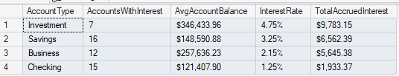
PRINT 'FEE REVENUE ANALYSIS:';
SELECT
account_type AS AccountType,
FORMAT(total_fees, 'C2') AS TotalFeeRevenue,
fee_count AS TransactionCount,
FORMAT(avg_fee, 'C2') AS AvgFeeAmount
FROM #Step5_FeeRevenue
ORDER BY total_fees DESC;
PRINT '';
PRINT 'INTEREST ACCRUALS:';
SELECT
a.account_type AS AccountType,
COUNT(*) AS AccountsWithInterest,
FORMAT(AVG(i.avg_balance), 'C2') AS AvgAccountBalance,
FORMAT(AVG(i.interest_rate * 100), 'N2') + '%' AS InterestRate,
FORMAT(SUM(i.accrued_interest), 'C2') AS TotalAccruedInterest
FROM #Step8_InterestAccruals i
JOIN accounts a ON i.account_id = a.account_id
GROUP BY a.account_type
ORDER BY SUM(i.accrued_interest) DESC;
PRINT '';

Slide 38
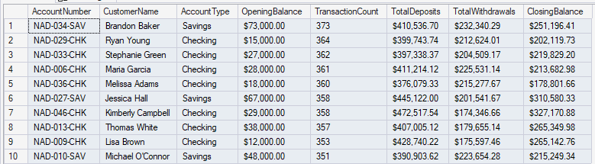
PRINT '';
PRINT 'TOP 10 ACCOUNTS BY ACTIVITY:';
SELECT TOP 10
a.account_number AS AccountNumber,
a.customer_name AS CustomerName,
a.account_type AS AccountType,
FORMAT(a.opening_balance, 'C2') AS OpeningBalance,
COUNT(t.transaction_id) AS TransactionCount,
FORMAT(SUM(CASE WHEN t.amount > 0 THEN t.amount ELSE 0 END), 'C2') AS TotalDeposits,
FORMAT(SUM(CASE WHEN t.amount < 0 THEN ABS(t.amount) ELSE 0 END), 'C2') AS TotalWithdrawals,
FORMAT(a.opening_balance + SUM(t.amount), 'C2') AS ClosingBalance
FROM accounts a
LEFT JOIN #Step1_Transactions t ON a.account_id = t.account_id
GROUP BY a.account_number, a.customer_name, a.account_type, a.opening_balance
ORDER BY COUNT(t.transaction_id) DESC;
PRINT '';

Slide 39
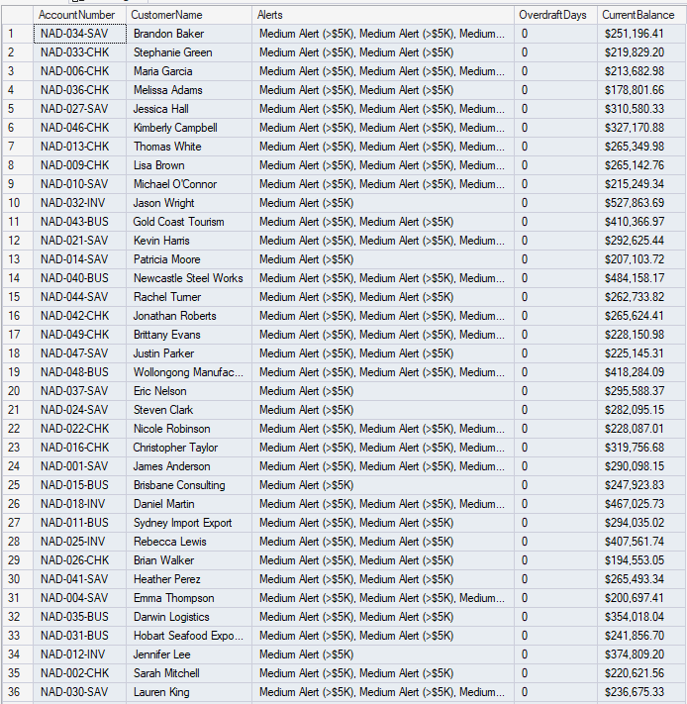
PRINT 'ACCOUNTS REQUIRING ATTENTION:';
SELECT
a.account_number AS AccountNumber,
a.customer_name AS CustomerName,
STUFF((
SELECT ', ' + flag_reason
FROM #Step4_SuspiciousTransactions s
WHERE s.account_id = a.account_id
FOR XML PATH(''), TYPE
).value('.', 'NVARCHAR(MAX)'), 1, 2, '') AS Alerts,
ISNULL(o.OverdraftDays, 0) AS OverdraftDays,
FORMAT(a.opening_balance + ISNULL(SUM(t.amount), 0), 'C2') AS CurrentBalance
FROM accounts a
LEFT JOIN #Step1_Transactions t ON a.account_id = t.account_id
LEFT JOIN (
SELECT account_id, COUNT(DISTINCT overdraft_date) AS OverdraftDays
FROM #Step3_Overdrafts
GROUP BY account_id
) o ON a.account_id = o.account_id
WHERE EXISTS (SELECT 1 FROM #Step4_SuspiciousTransactions WHERE account_id = a.account_id)
OR EXISTS (SELECT 1 FROM #Step3_Overdrafts WHERE account_id = a.account_id)
GROUP BY a.account_number, a.customer_name, a.account_id, a.opening_balance, o.OverdraftDays
ORDER BY ISNULL(o.OverdraftDays, 0) DESC, COUNT(t.transaction_id) DESC;
First 36 rows of accounts that requires ATTENTION!!

Slide 40
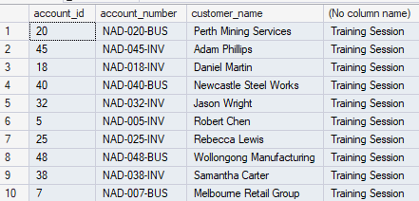
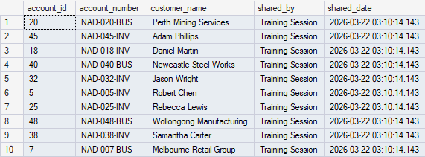
DDL: Create Global temp table #SharedAccountList
-- Create global temp table (visible to ALL sessions)
CREATE TABLE ##SharedAccountList (
account_id INT,
account_number NVARCHAR(20),
customer_name NVARCHAR(100),
shared_by NVARCHAR(100),
shared_date DATETIME DEFAULT GETDATE()
);
INSERT INTO ##SharedAccountList (account_id, account_number, customer_name, shared_by)
SELECT TOP 10
account_id,
account_number,
customer_name,
'Training Session'
FROM accounts
ORDER BY opening_balance DESC;
PRINT 'Global temp table ##SharedAccountList created.';
PRINT 'This table is visible to ALL sessions until the last session using it disconnects.';
PRINT '';
SELECT * FROM ##SharedAccountList;
PRINT '';
PRINT 'Use Case: Share reference data across multiple analyst sessions';
PRINT 'Caution: Naming conflicts possible, use permanent tables for true shared data';
PRINT ‘’;
-- Cleanup
DROP TABLE ##SharedAccountList;
PRINT '✓ Global temp table dropped';
PRINT '';
GO

Slide 41
Stored Procedure for dbo.MonthEndReconciliation
CREATE PROCEDURE dbo.MonthEndReconciliation
@Year INT,
@Month INT,
@ShowDetails BIT = 1
AS
BEGIN
SET NOCOUNT ON;
-- Validate parameters
IF @Year < 2020 OR @Year > 2030
BEGIN
RAISERROR('Year must be between 2020 and 2030', 16, 1);
RETURN;
END
IF @Month < 1 OR @Month > 12
BEGIN
RAISERROR('Month must be between 1 and 12', 16, 1);
RETURN;
END

Slide 42
-- Calculate date range
DECLARE @StartDate DATE = DATEFROMPARTS(@Year, @Month, 1);
DECLARE @EndDate DATE = DATEADD(MONTH, 1, @StartDate);
DECLARE @MonthName NVARCHAR(20) = DATENAME(MONTH, @StartDate);
PRINT '================================================================================';
PRINT 'MONTH-END RECONCILIATION: ' + @MonthName + ' ' + CAST(@Year AS NVARCHAR(4));
PRINT '================================================================================';
PRINT '';
-- STEP 1: Extract Transactions
CREATE TABLE #Transactions (
transaction_id INT,
account_id INT,
transaction_date DATETIME,
amount DECIMAL(15,2),
transaction_type NVARCHAR(50)
);
INSERT INTO #Transactions
SELECT transaction_id, account_id, transaction_date, amount, transaction_type
FROM transactions
WHERE transaction_date >= @StartDate AND transaction_date < @EndDate;
CREATE INDEX IX_Account ON #Transactions(account_id);

Slide 43
DECLARE @TxCount INT = (SELECT COUNT(*) FROM #Transactions);
PRINT 'Extracted ' + CAST(@TxCount AS NVARCHAR(10)) + ' transactions';
-- STEP 2: Account Summary
CREATE TABLE #AccountSummary (
account_id INT,
opening_balance DECIMAL(15,2),
total_deposits DECIMAL(15,2),
total_withdrawals DECIMAL(15,2),
net_change DECIMAL(15,2),
closing_balance DECIMAL(15,2)
);
INSERT INTO #AccountSummary
SELECT
a.account_id,
a.opening_balance,
ISNULL(SUM(CASE WHEN t.amount > 0 THEN t.amount ELSE 0 END), 0),
ISNULL(SUM(CASE WHEN t.amount < 0 THEN ABS(t.amount) ELSE 0 END), 0),
ISNULL(SUM(t.amount), 0),
a.opening_balance + ISNULL(SUM(t.amount), 0)
FROM accounts a
LEFT JOIN #Transactions t ON a.account_id = t.account_id
GROUP BY a.account_id, a.opening_balance;

Slide 44
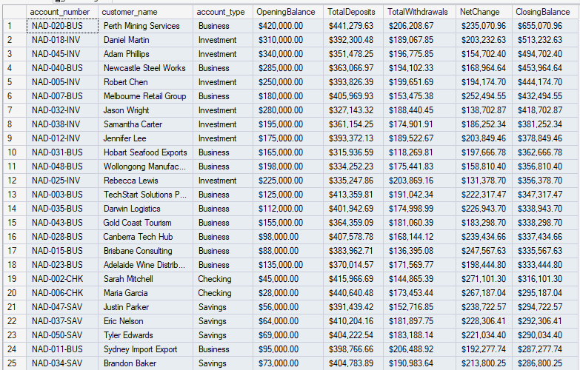
-- Final Report
PRINT '';
PRINT 'RECONCILIATION SUMMARY:';
SELECT
a.account_number,
a.customer_name,
a.account_type,
FORMAT(s.opening_balance, 'C2') AS OpeningBalance,
FORMAT(s.total_deposits, 'C2') AS TotalDeposits,
FORMAT(s.total_withdrawals, 'C2') AS TotalWithdrawals,
FORMAT(s.net_change, 'C2') AS NetChange,
FORMAT(s.closing_balance, 'C2') AS ClosingBalance
FROM #AccountSummary s
JOIN accounts a ON s.account_id = a.account_id
ORDER BY s.closing_balance DESC;
-- Cleanup
DROP TABLE #Transactions;
DROP TABLE #AccountSummary;
PRINT '';
PRINT '✓ Reconciliation completed successfully';
END
GO
-- Test the procedure
EXEC dbo.MonthEndReconciliation @Year = 2024, @Month = 12;
GO
First 25 rows for the Final Report: Reconciliation Summary

Slide 45
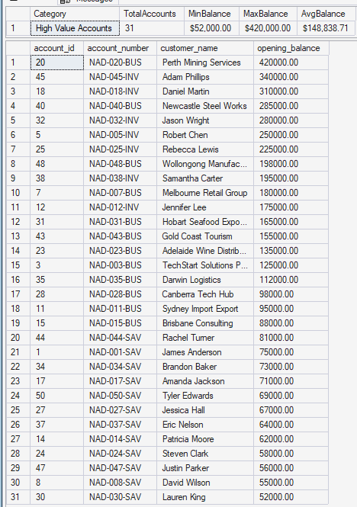
Temp Table for #HighValueCounts
CREATE TABLE #HighValueAccounts (
account_id INT,
account_number NVARCHAR(20),
customer_name NVARCHAR(100),
opening_balance DECIMAL(15,2)
);
INSERT INTO #HighValueAccounts
SELECT account_id, account_number, customer_name, opening_balance
FROM accounts
WHERE opening_balance > 50000;
SELECT
'High Value Accounts' AS Category,
COUNT(*) AS TotalAccounts,
FORMAT(MIN(opening_balance), 'C2') AS MinBalance,
FORMAT(MAX(opening_balance), 'C2') AS MaxBalance,
FORMAT(AVG(opening_balance), 'C2') AS AvgBalance
FROM #HighValueAccounts;
SELECT * FROM #HighValueAccounts ORDER BY opening_balance DESC;
DROP TABLE #HighValueAccounts;
PRINT '✓ Exercise 1 completed';
PRINT '';
GO

Slide 46
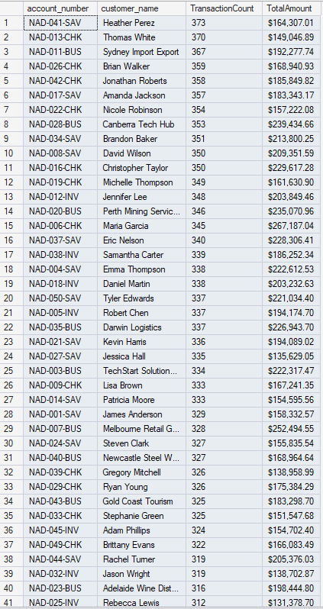
Table Variable for Small Dataset for @TransactionSummary
DECLARE @TransactionSummary TABLE (
account_id INT,
total_amount DECIMAL(15,2),
tx_count INT
);
INSERT INTO @TransactionSummary
SELECT
account_id,
SUM(amount) AS total_amount,
COUNT(*) AS tx_count
FROM transactions
WHERE transaction_date >= '2024-12-01' AND transaction_date < '2025-01-01'
GROUP BY account_id;
SELECT
a.account_number,
a.customer_name,
ts.tx_count AS TransactionCount,
FORMAT(ts.total_amount, 'C2') AS TotalAmount
FROM @TransactionSummary ts
JOIN accounts a ON ts.account_id = a.account_id
WHERE ts.tx_count > 10
ORDER BY ts.tx_count DESC;
PRINT '✓ Exercise 2 completed';
PRINT '';
GO
First 41 Rows for @TransactionSummary

Slide 47
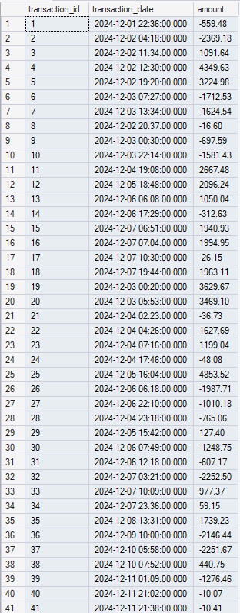
Temp Table for #AllTransactions and #DailyTotals
-- Step 1: Extract December transactions
CREATE TABLE #AllTransactions (
transaction_id INT,
transaction_date DATETIME,
amount DECIMAL(15,2)
);
INSERT INTO #AllTransactions
SELECT transaction_id, transaction_date, amount
FROM transactions
WHERE transaction_date >= '2024-12-01' AND transaction_date < '2025-01-01';
-- Making some changes
-- PRINT 'Step 1: Extracted ' + CAST((SELECT COUNT(*) FROM #AllTransactions) AS NVARCHAR(10)) + ' transactions';
DECLARE @Step1Count INT;
SELECT @Step1Count = COUNT(*) FROM #AllTransactions;
PRINT 'Step 1: Extracted ' + CAST(@Step1Count AS NVARCHAR(10)) + ' transactions';
Here were showing the first 41 rows containing All Transactions occurring in December 2024

Slide 48
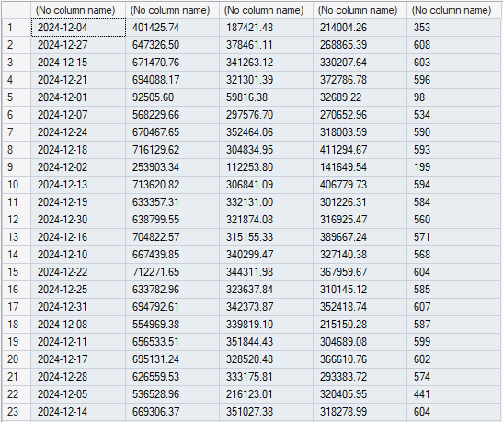
-- Step 2: Create daily totals
CREATE TABLE #DailyTotals (
transaction_date DATE,
daily_deposits DECIMAL(15,2),
daily_withdrawals DECIMAL(15,2),
daily_net DECIMAL(15,2),
transaction_count INT
);
INSERT INTO #DailyTotals
SELECT
CAST(transaction_date AS DATE),
SUM(CASE WHEN amount > 0 THEN amount ELSE 0 END),
SUM(CASE WHEN amount < 0 THEN ABS(amount) ELSE 0 END),
SUM(amount),
COUNT(*)
FROM #AllTransactions
GROUP BY CAST(transaction_date AS DATE);
--Modify this
--PRINT 'Step 2: Aggregated into ' + CAST((SELECT COUNT(*) FROM #DailyTotals) AS NVARCHAR(10)) + ' daily records';
DECLARE @DailyCount INT;
SELECT @DailyCount = COUNT(*) FROM #DailyTotals;
PRINT 'Step 2: Aggregated into ' + CAST(@DailyCount AS NVARCHAR(10)) + ' daily records';
PRINT '';
First 23 rows, containing Daily Totals, from
December 2024, daily deposits, withdrawals,
daily net, transaction count

Slide 49
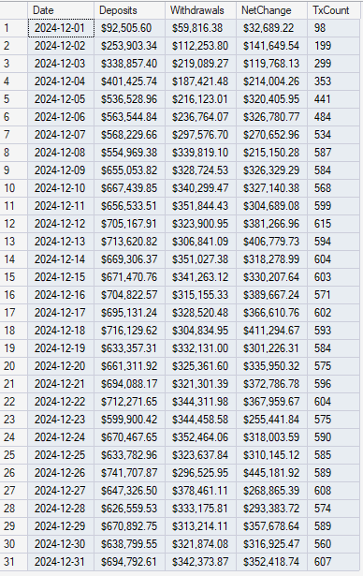
-- Step 3: Show daily trends
PRINT 'Step 3: Daily Transaction Trends:';
SELECT
transaction_date AS Date,
FORMAT(daily_deposits, 'C2') AS Deposits,
FORMAT(daily_withdrawals, 'C2') AS Withdrawals,
FORMAT(daily_net, 'C2') AS NetChange,
transaction_count AS TxCount
FROM #DailyTotals
ORDER BY transaction_date;

Slide 50
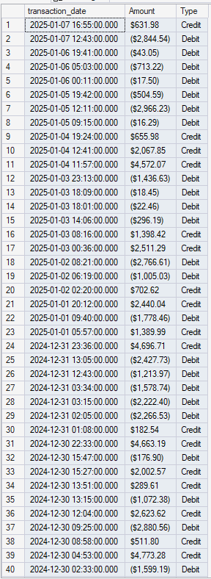
Temp Table with All Transactions, #AllTx
-- Create temp table with all transactions
CREATE TABLE #AllTx (
transaction_id INT,
account_id INT,
transaction_date DATETIME,
amount DECIMAL(15,2)
);
INSERT INTO #AllTx
SELECT transaction_id, account_id, transaction_date, amount
FROM transactions;
--PRINT 'Temp table created with ' + CAST((SELECT COUNT(*) FROM #AllTx) AS NVARCHAR(10)) + ' records';
-- Modifying.
DECLARE @Cnt INT;
SELECT @Cnt = COUNT(*) FROM #AllTx;
PRINT 'Temp table created with ' + CAST(@Cnt AS NVARCHAR(10)) + ' records';
-- Query for specific account
DECLARE @TestAccountID INT = (SELECT TOP 1 account_id FROM accounts ORDER BY NEWID());
PRINT 'Querying transactions for account_id: ' + CAST(@TestAccountID AS NVARCHAR(10));
SELECT
transaction_date,
FORMAT(amount, 'C2') AS Amount,
CASE WHEN amount > 0 THEN 'Credit' ELSE 'Debit' END AS Type
FROM #AllTx
WHERE account_id = @TestAccountID
ORDER BY transaction_date DESC;
First 40 rows for All Transactions for #AllTx

Slide 51
Stored Procedure for dbo.QuarterlyReconciliation
CREATE PROCEDURE dbo.QuarterlyReconciliation
@Year INT,
@Quarter INT
AS
BEGIN
SET NOCOUNT ON;
-- Validate inputs
IF @Quarter NOT IN (1, 2, 3, 4)
BEGIN
RAISERROR('Quarter must be 1, 2, 3, or 4', 16, 1);
RETURN;
END
-- Calculate quarter start and end
DECLARE @StartMonth INT = (@Quarter - 1) * 3 + 1;
DECLARE @StartDate DATE = DATEFROMPARTS(@Year, @StartMonth, 1);
DECLARE @EndDate DATE = DATEADD(MONTH, 3, @StartDate);

Slide 52
PRINT '================================================================================';
PRINT 'QUARTERLY RECONCILIATION: Q' + CAST(@Quarter AS NVARCHAR(1)) + ' ' + CAST(@Year AS NVARCHAR(4));
PRINT 'Period: ' + CONVERT(NVARCHAR(10), @StartDate, 120) + ' to ' + CONVERT(NVARCHAR(10), @EndDate, 120);
PRINT '================================================================================';
PRINT '';
-- Step 1: Extract quarter transactions
CREATE TABLE #QuarterTransactions (
transaction_id INT,
account_id INT,
amount DECIMAL(15,2)
);
INSERT INTO #QuarterTransactions
SELECT transaction_id, account_id, amount
FROM transactions
WHERE transaction_date >= @StartDate AND transaction_date < @EndDate;
CREATE INDEX IX_Account ON #QuarterTransactions(account_id);
-- Step 2: Calculate quarterly summary
CREATE TABLE #QuarterlySummary (
account_id INT,
opening_balance DECIMAL(15,2),
quarter_deposits DECIMAL(15,2),
quarter_withdrawals DECIMAL(15,2),
closing_balance DECIMAL(15,2)
);

Slide 53
INSERT INTO #QuarterlySummary
SELECT
a.account_id,
a.opening_balance,
ISNULL(SUM(CASE WHEN t.amount > 0 THEN t.amount ELSE 0 END), 0),
ISNULL(SUM(CASE WHEN t.amount < 0 THEN ABS(t.amount) ELSE 0 END), 0),
a.opening_balance + ISNULL(SUM(t.amount), 0)
FROM accounts a
LEFT JOIN #QuarterTransactions t ON a.account_id = t.account_id
GROUP BY a.account_id, a.opening_balance;
-- Final report
PRINT 'QUARTERLY SUMMARY BY ACCOUNT:';
SELECT
a.account_number AS AccountNumber,
a.customer_name AS CustomerName,
a.account_type AS AccountType,
FORMAT(q.opening_balance, 'C2') AS OpeningBalance,
FORMAT(q.quarter_deposits, 'C2') AS QuarterDeposits,
FORMAT(q.quarter_withdrawals, 'C2') AS QuarterWithdrawals,
FORMAT(q.closing_balance, 'C2') AS ClosingBalance,
FORMAT(q.closing_balance - q.opening_balance, 'C2') AS NetChange
FROM #QuarterlySummary q
JOIN accounts a ON q.account_id = a.account_id
ORDER BY q.closing_balance DESC;

Slide 54
PRINT '';
PRINT 'QUARTERLY TOTALS:';
SELECT
'Total Accounts' AS Metric,
FORMAT(COUNT(*), 'N0') AS Value
FROM #QuarterlySummary
UNION ALL
SELECT
'Total Deposits',
FORMAT(SUM(quarter_deposits), 'C2')
FROM #QuarterlySummary
UNION ALL
SELECT
'Total Withdrawals',
FORMAT(SUM(quarter_withdrawals), 'C2')
FROM #QuarterlySummary
UNION ALL
SELECT
'Net Portfolio Change',
FORMAT(SUM(closing_balance - opening_balance), 'C2')
FROM #QuarterlySummary;
-- Cleanup
DROP TABLE #QuarterTransactions;
DROP TABLE #QuarterlySummary;
PRINT '';
PRINT '✓ Quarterly reconciliation completed successfully';
END
GO

Slide 55
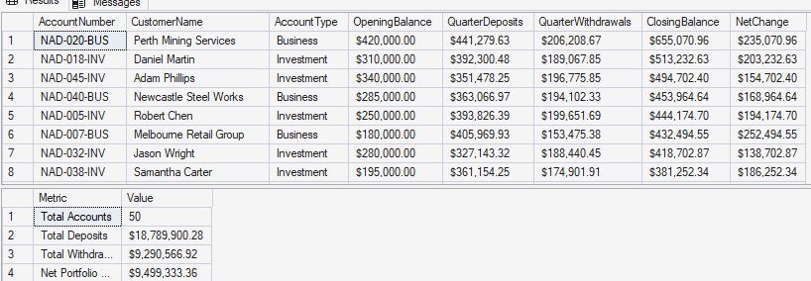
PRINT '✓ Stored procedure dbo.QuarterlyReconciliation created';
PRINT '';
-- Test the procedure for Q4 2024
PRINT 'Testing QuarterlyReconciliation for Q4 2024:';
PRINT '';
EXEC dbo.QuarterlyReconciliation @Year = 2024, @Quarter = 4;
GO

Slide 56

Scenario 1: Small Dataset, single use -> Table Variable
PRINT 'Scenario 1: Quick lookup list (20 account IDs) → TABLE VARIABLE';
DECLARE @AccountList TABLE (account_id INT);
INSERT INTO @AccountList VALUES (1), (2), (3), (5), (8), (13), (21), (34);
SELECT COUNT(*) AS AccountCount FROM @AccountList;
PRINT '✓ Table variable perfect for small, temporary lists';
PRINT '';

Slide 57

Scenario 2: Large Dataset, multiple steps -> Temp Table
PRINT 'Scenario 2: Process 15,000 transactions → TEMP TABLE';
CREATE TABLE #LargeProcess (
transaction_id INT,
amount DECIMAL(15,2)
);
INSERT INTO #LargeProcess SELECT transaction_id, amount FROM transactions;
CREATE INDEX IX_Amount ON #LargeProcess(amount); -- Can add index!
SELECT COUNT(*) AS RecordCount FROM #LargeProcess WHERE amount > 1000;
DROP TABLE #LargeProcess;
PRINT '✓ Temp table with index for large datasets';
PRINT '';

Slide 58
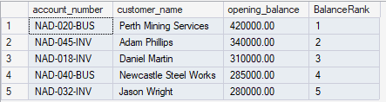
Scenario 3: Single query readability -> CTE
PRINT 'Scenario 3: Readable one-time ranking query → CTE';
WITH AccountRanking AS (
SELECT
account_number,
customer_name,
opening_balance,
ROW_NUMBER() OVER (ORDER BY opening_balance DESC) AS BalanceRank
FROM accounts
)
SELECT * FROM AccountRanking WHERE BalanceRank <= 5;
PRINT '✓ CTE perfect for single-query readability';
PRINT '';

